Slide 1

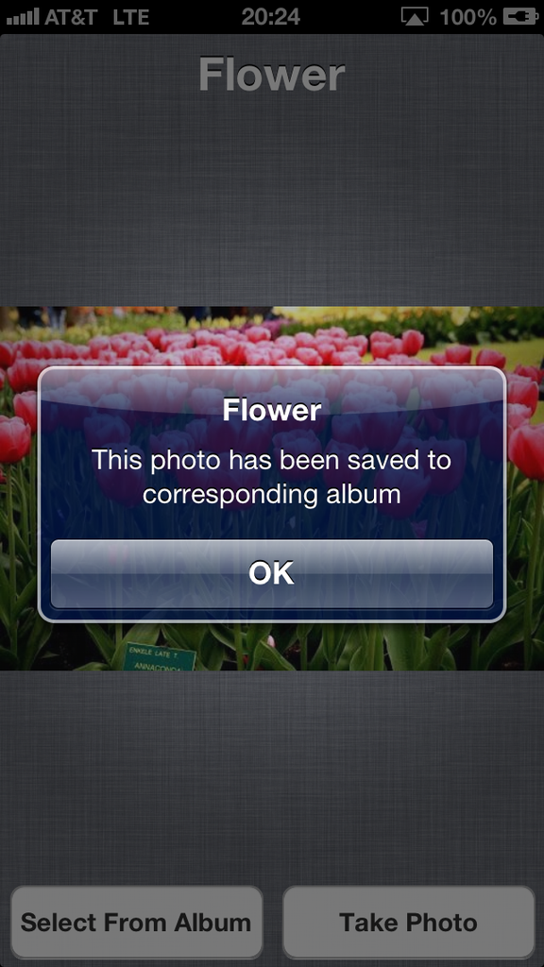
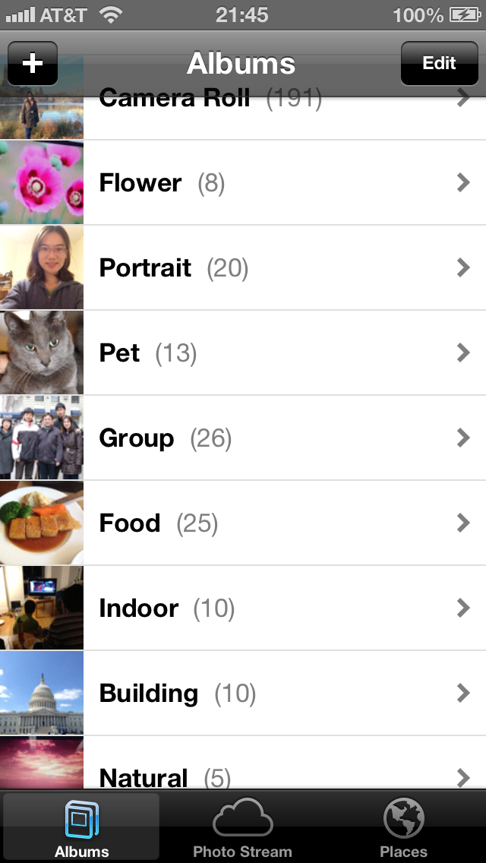
Smart Album
Computer Vision Project Presentation
An iOS app for photo management
By
Yin Cui (yc2776)
Xingyue Zhou (xz2299)

Slide 2

Motivation and Achievements
Photo taking is everywhere.
Managing photos sometimes becomes a burden.
Want to implement automatic content-based photo classification, especially on mobile device.
Implemented Smart Album.
Achieved an accuracy of 83.1%.
Successfully classified 8 classes on iPhone.
Notes:
Existing applications such as Aperture and Picasa, can not implement automatic content-based photo classification.

Slide 3
portrait
group
flower
pet
food
building
indoor
natural
Training Data: ~300 images per class (except Portrait and Group),
randomly downloaded from Image-Net

Slide 4
Bag-of-Words and Spatial-Pyramid-Matching
SPM 1x1
SPM 2x2
SPM 3x1
Pictures from Koen E. A. van de Sande et al.

Slide 5
Framework
Codes
Training
Images
Dense SIFT
NN, KNN, SC
Features
K-means
Dictionary
Linear, HIK
Test Image
Features
Codes
SVM
Classifier
Album

Slide 6
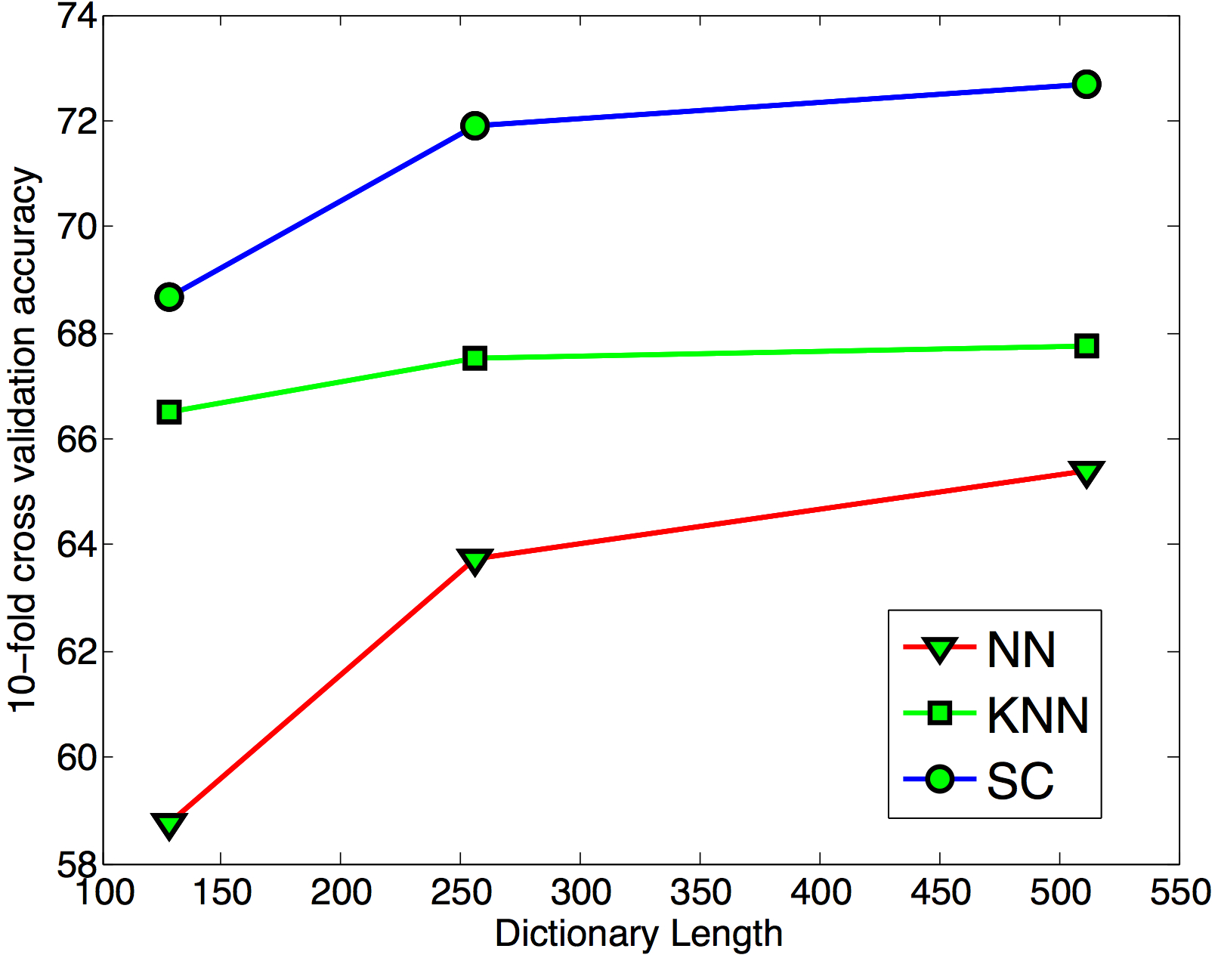
Experiment
10-fold cross validation (Linear SVM, no SPM)

Slide 7
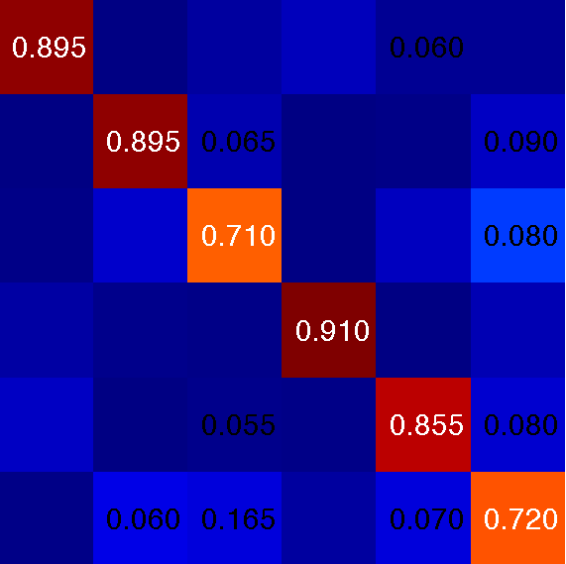
Experiment
Best results so far: 83.10% (512 dict. length + SC + SPM + HIK SVM)
building
food
flower
indoor
natural
pet
building
food
flower
indoor
natural
pet

Slide 8
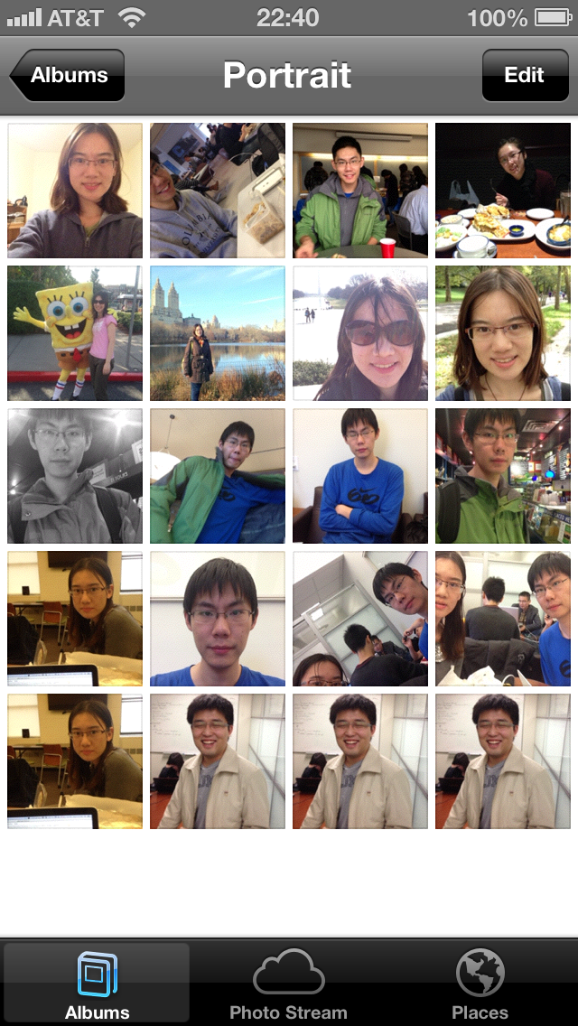
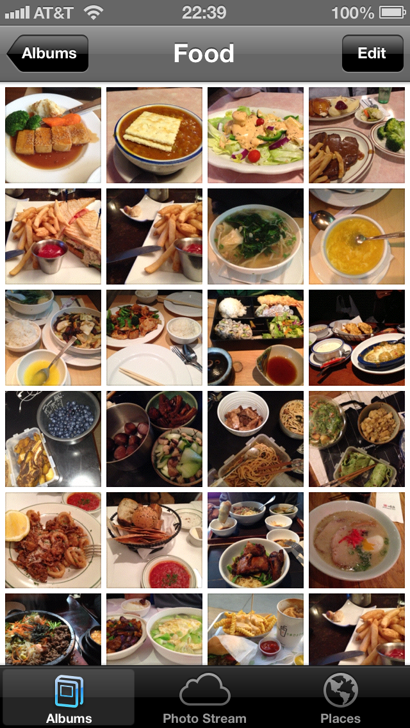
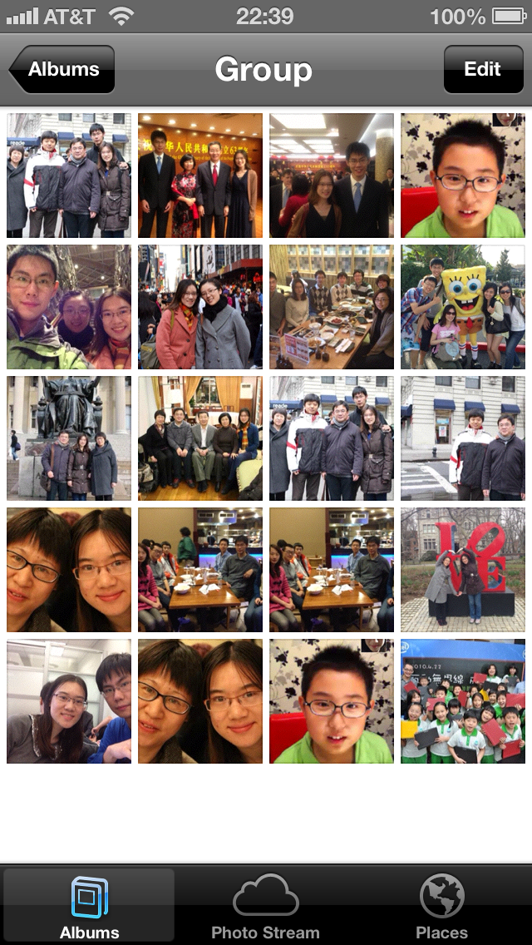
Application on iOS
Platform: iOS 5.0 and later
Language: objective C and C++ (OpenCV)
Key points:
Train SVM when app launches
Take advantage of Apple’s face detector (CIDetector)
Trade off between speed and accuracy

Slide 9
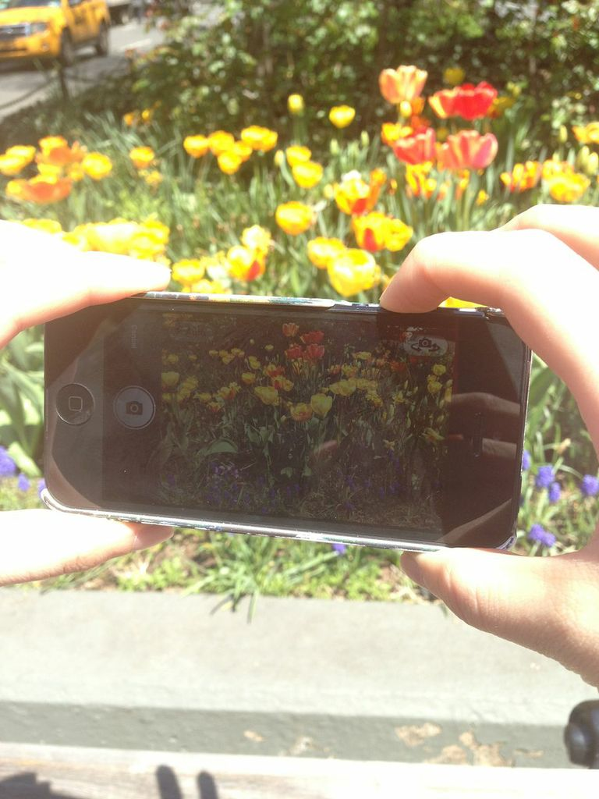
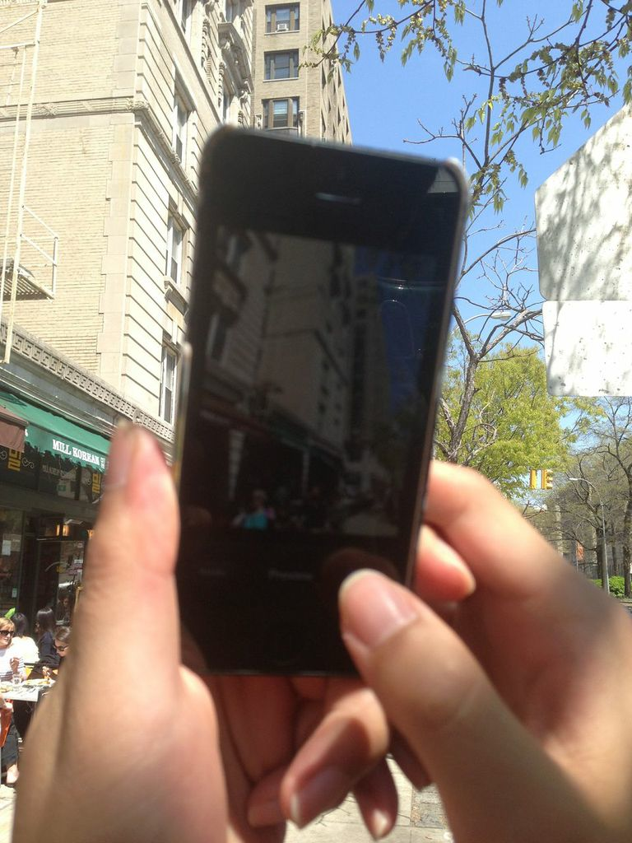
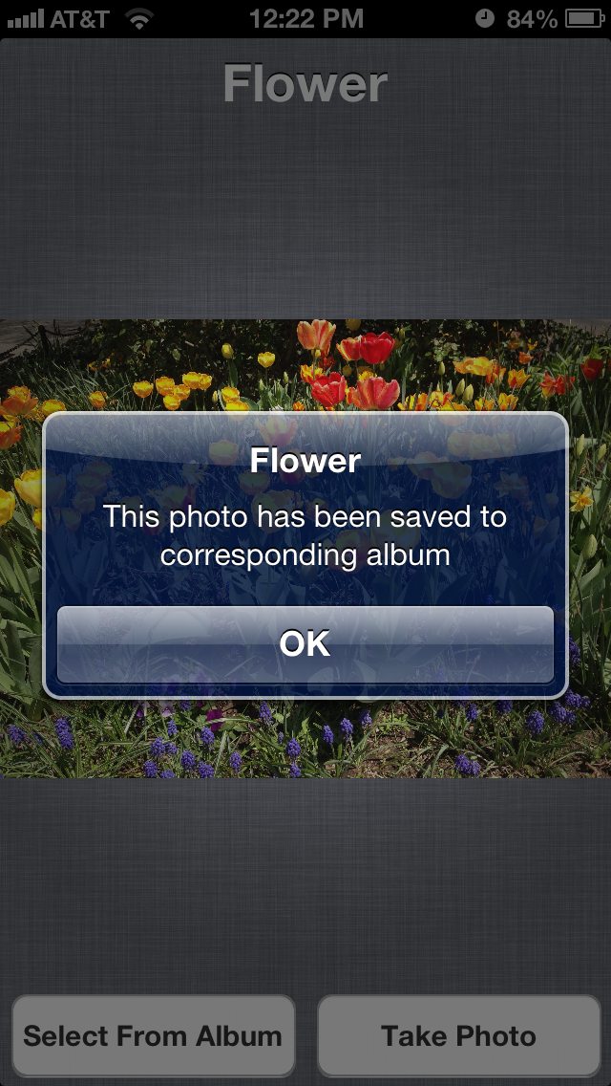
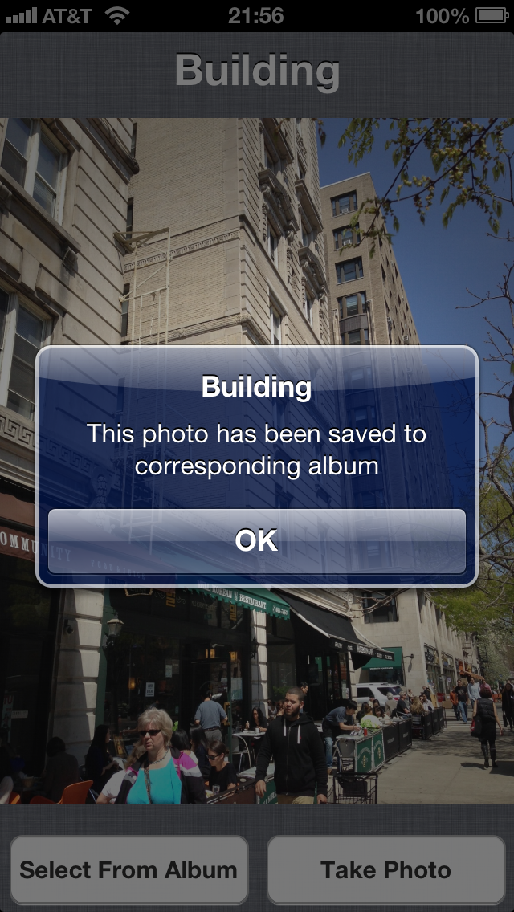
Screenshot and Live Demo

